Slide 1
Title/Team
Notes:
Last updated March 9th 2006
Created Spring 2003
Author: J. Maletic
General overview of Computer Science Undergraduate Program

Slide 2
Introduction
This project is to implement to do a web application enhancements called Request Us Page for requesting of required items likes tables,books,computers….. to gain best education for less budget schools or free schools for the existing application name called “chatrasahaya”.So that end users can submit the needs of required items whenever required for the schools and users can view the counts on maps and requsters details
Major Functions are:
•Request Us Form --- Submitting of the Request of needs for the schools
•Mail Notification ---Sending of the Mail Notifications for the Request to our team
•Map View -- To show the counts by the state level in the Map
•Count View --- To view the details for the each service provided with the images

Slide 3
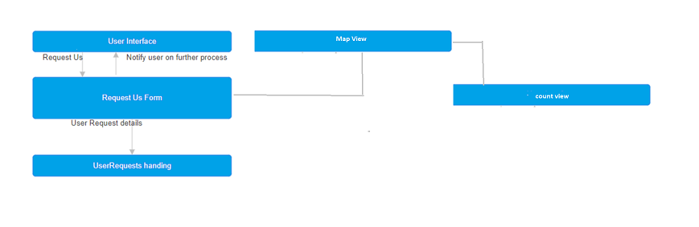
Architecture Diagram

Slide 4
Major Functions
3.1.1 User Interface
User Interface is a function that user can interact with application and perform certain actions like viewing of counts in map and counts details and can request services from Chatrasahaya with a new feature Request Us
3.1.2 Request Us form
This is the main function which allows user to request for the services provided by Chatrasahaya
3.1.3 Mail Notification: After End users clicking on Submit button with the valid data , A mail will be sent to the chatrasahaya team mail id to get to know the requester details.
3.1.4 Map View
This is the function where Users/Team can see the counts of the request services provided by Chatrasahaya team on the map view
3.1.5 Count View
This is the function where Users/Team can see the details such as name of the requester,location & category… of the counts on the map view

Slide 5
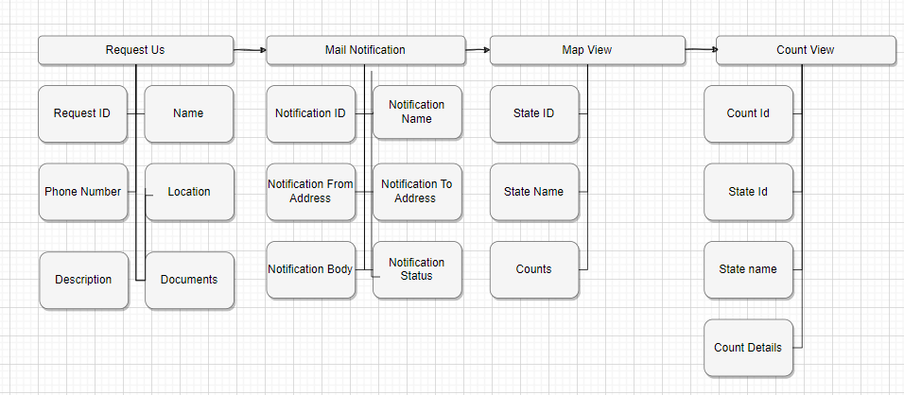
DB Design
Database(s) created as part of the application is(are) described.
Below is the table designed for application.
UserRequests ( Select * from UserRequests )
Table Columns:
Request ID
Name
Phone Number
Location
Description
Documents
Aadhar ID
Category
On the Map view, We will show the count based on location and rows for the selected location/state
On the Count View, We will show the requester details itself anyway which was pressent in the UserRequests Table

Slide 6
UI Design of Request US Form

Slide 7
Class Diagram
For the Application , we are adding the new features such as request us, map view and count view using the same class objects

Slide 8
Software Interface/Implementation
Software Interface Description
The software interface(s) to the outside world is(are) described.
External machine interfaces
Interfaces to other machines (computers or devices) are described.
1.Operating System: Windows 11
2.Microsoft Visual Studio
3.WordPress PHP on Go-daddy itself
4.Microsoft SQL Server Management Studio
5.Java/python Development Toolkit.
External system interfaces
1.Users needs to have stable internet connection to access the application and requester details to submit the request
Human interface
An overview of any human interfaces to be designed for the software is presented.
Notes:
http://www.bls.gov/oco/ocos267.htm
http://www.internetweek.com/story/showArticle.jhtml?articleID=160900829
"Computer science and IT-related majors will see an increase in opportunities for the first time since the collapse of the dot.com sector," stated Dr. Philip Gardner, director of the Collegiate Employment Research Institute (CERI) at Michigan State University. "The information services sector is still facing hard times with overcapacity in the telecommunications sector and limited growth in on-line businesses."
www.naceweb.org

